Slide 1

Laboratory Project

Slide 2

Our Project
Create a peer-to-peer chat
Users can send/receive messages through a variety of different protocols
Use Wireshark to display the use of different protocols

Slide 3
Implemented Protocols
TCP
UDP
HTTP
ICMP
DNS
SSL

Slide 4
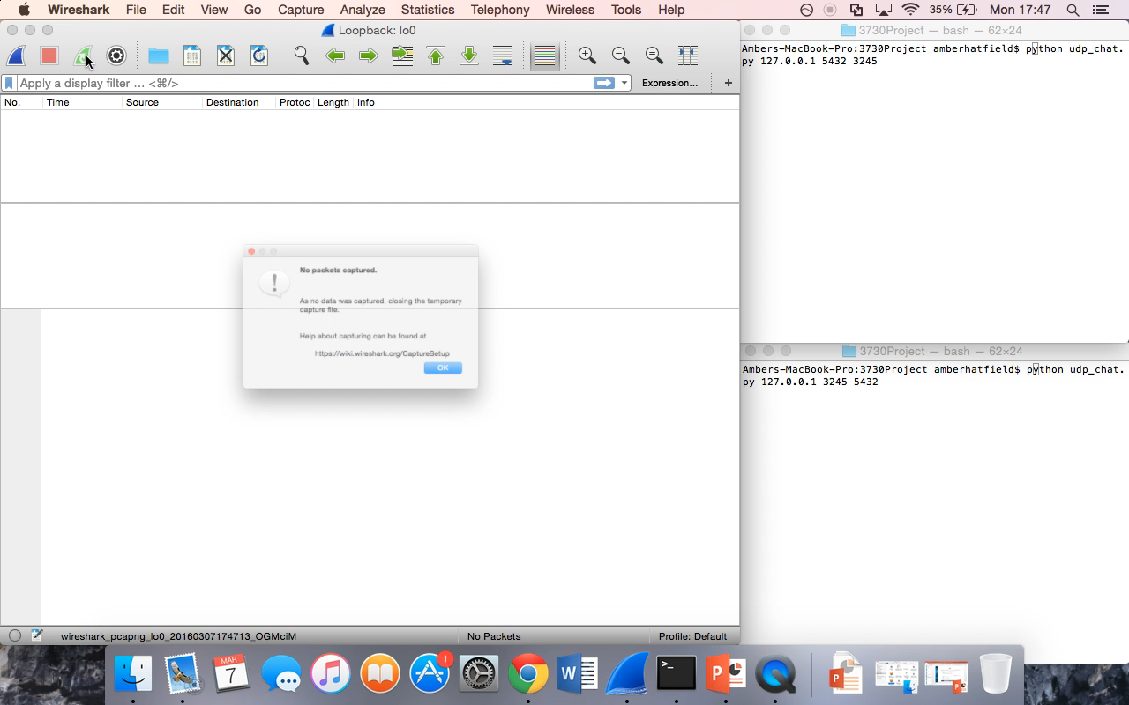
UDP

Slide 5
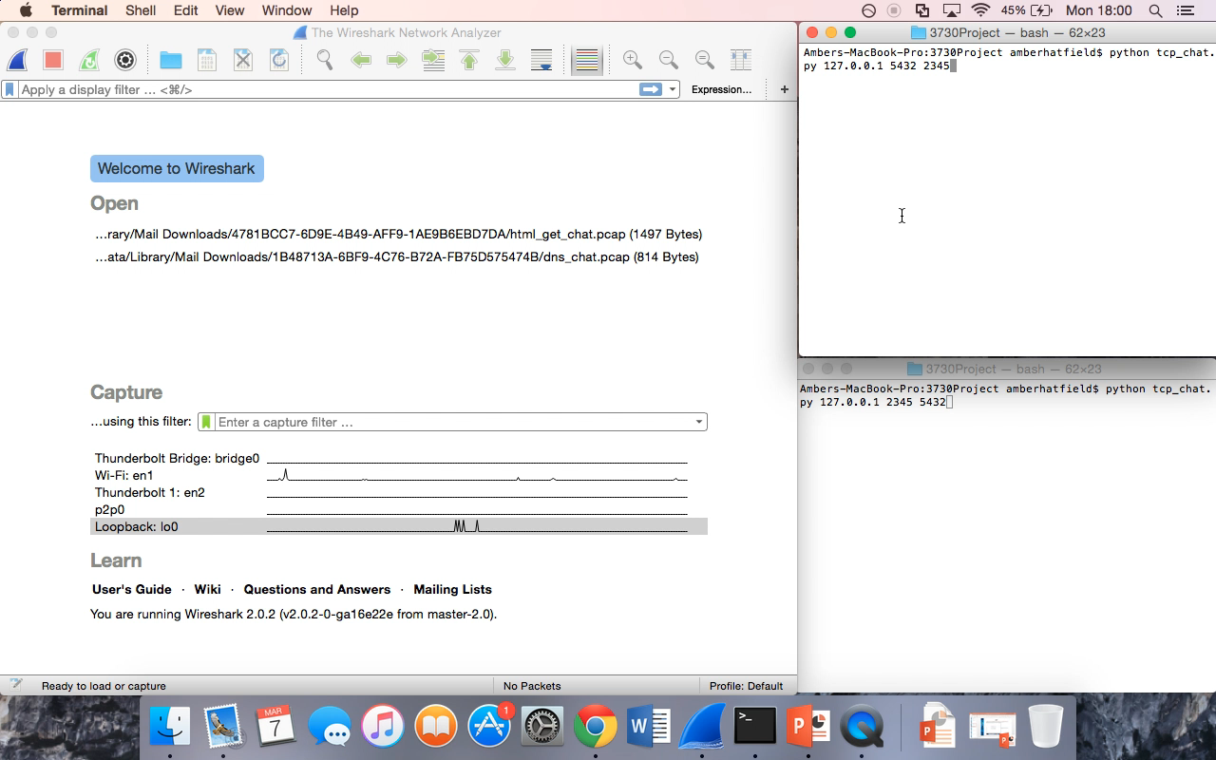
TCP

Slide 6
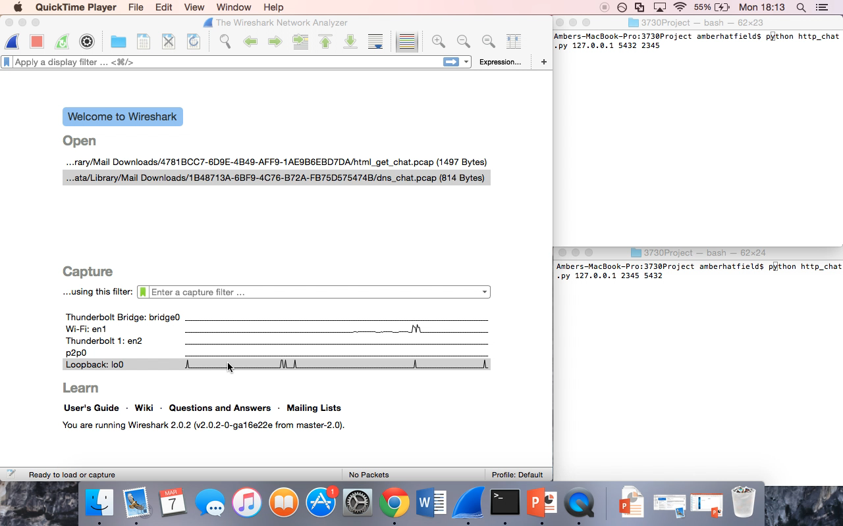
HTTP

Slide 7
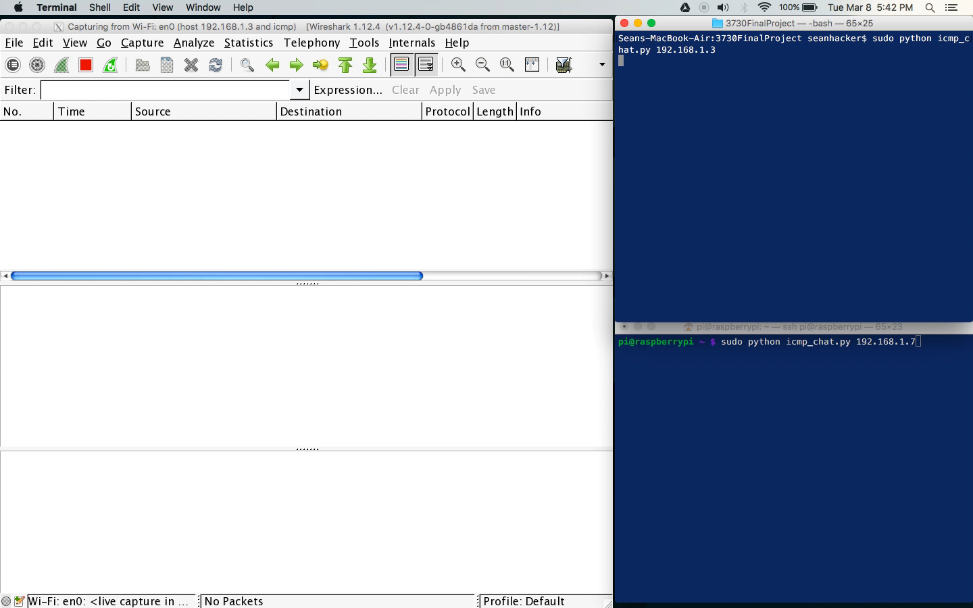
ICMP

Slide 8
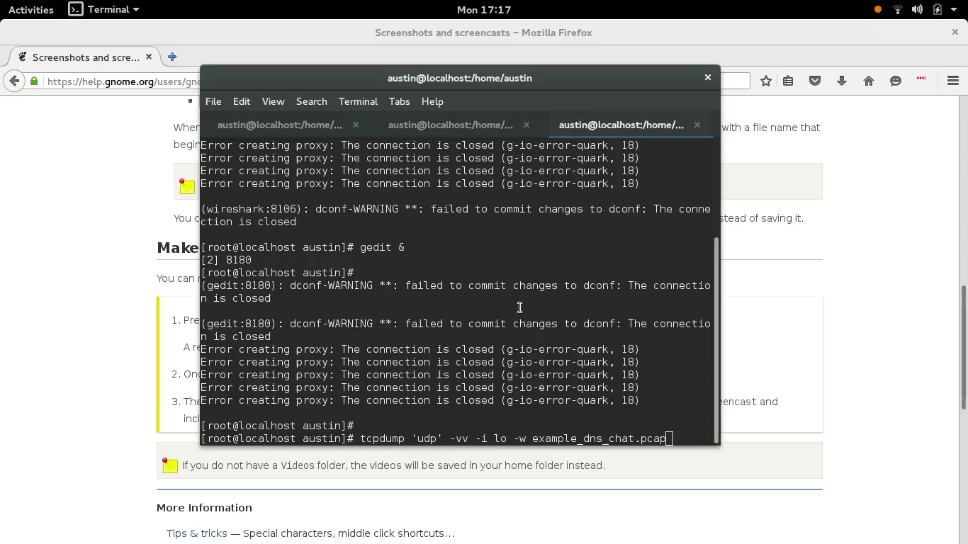
DNS

Slide 9
Lessons Learned
P2P Chat is harder than we thought...
Ensure everyone is using the same operating system
… and python/scapy/various coding tools
Google is our friend

Slide 10
Future Work
GUI Interface
Protocol Randomization
Encryption
Standardized Protocol Methods
Custom Protocols
Attachments

Slide 11

Questions?

